Slide 1
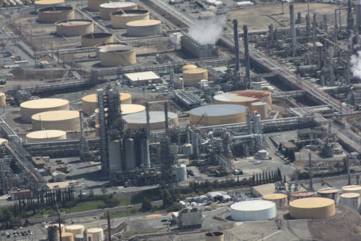
Gas Refinery
by Monica R. Hawkins
October 1, 2025
Gasoline prices rise in the spring and summer due to increased availability. During the winter, the price typically does not rise above $ 2.00. Because refiners are operating on May 1st to transition production to a winter blend of gasoline. The refiners have individuals operating there overnight; there should be a reason why gasoline has increased so much.
How can we prevent the refinery from raising gas prices above $4.00?
What can we do to persuade the United States Environmental Protection Agency to look into the refinery’s decision not to switch during the winter season?
Even if the refinery burns gasoline throughout the winter season, this does not keep the air clean.
My goal is to persuade gas refinery businesses not to increase gas prices during the spring and summer months and to avoid flaring or burning during the winter season. Additionally, I recommend that refineries investigate which states have experienced the greatest growth in gas consumption and production.

